Slide 1


Spatial Analysis in R: An introduction to data manipulation, spatial data analysis and statistical modeling Change detection and time-series analysis
Jeffrey S. Evans, Ph.D.,
Senior Landscape Ecologist & Biometrician
The Nature Conservancy | Protected Lands Science
Visiting Professor | University of Wyoming | Zoology & Physiology
Laramie, WY | jeffrey_evans@tnc.org | (970) 672-6766

Slide 2
Some advances in raster change detection for continuous process (we are way beyond Δ)

Slide 3
Change Detection
Desirable characteristics in change detection methods
Accounting for spatial variability
Weights (i.e., Fuzzy Set Theory, Kappa)
Thresholds (change by defined percent)
Intensity (i.e., Wavelets)
Spatial structure (autocorrelation)
Results are quite variable and very different than image differencing. Selected method depends on question!

Slide 4
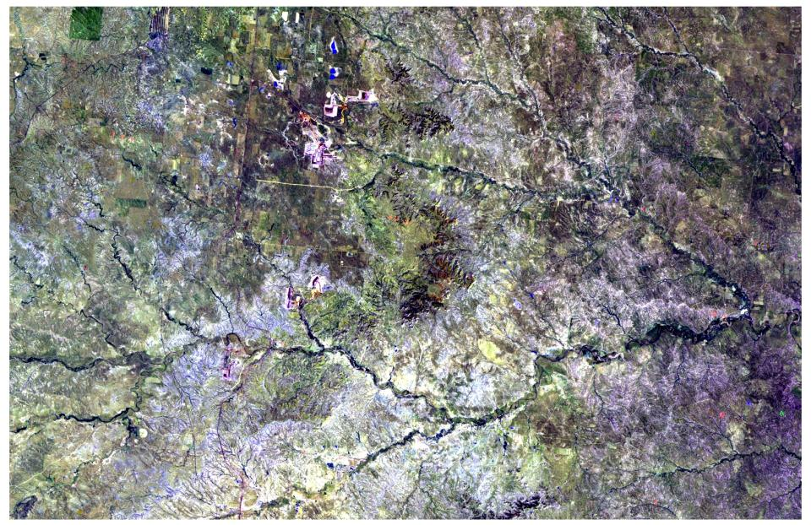
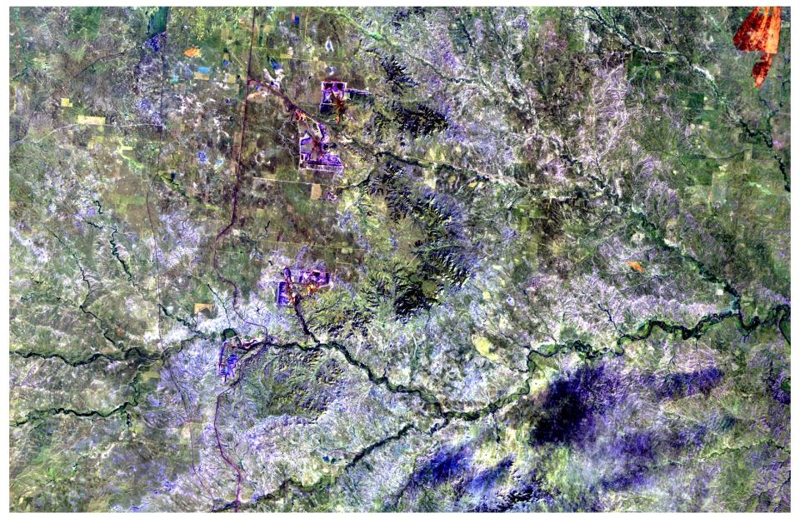
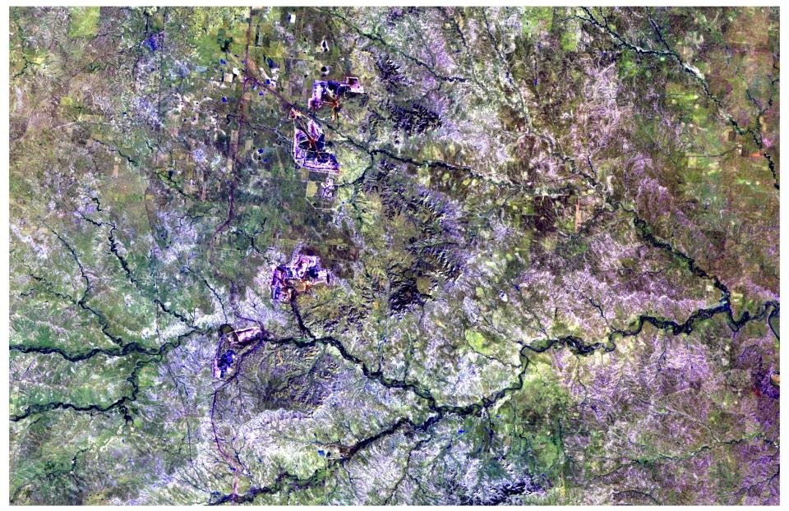
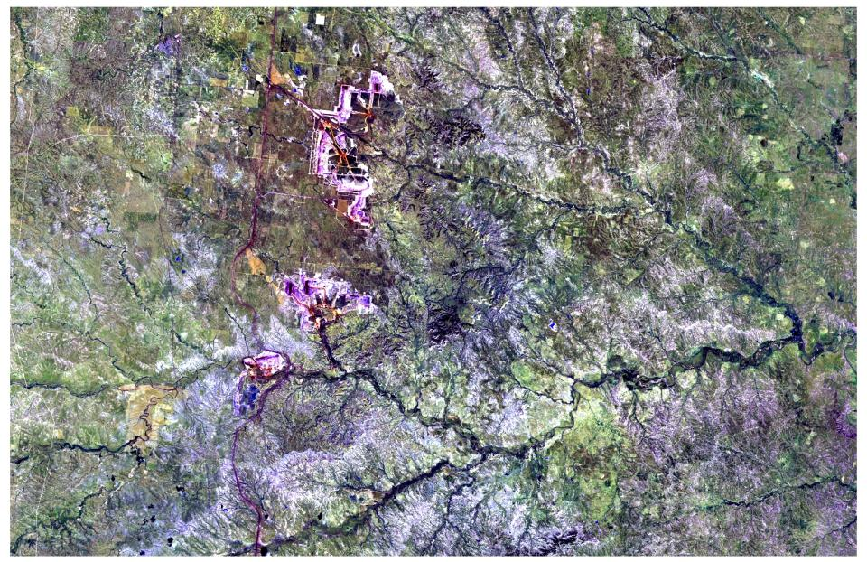
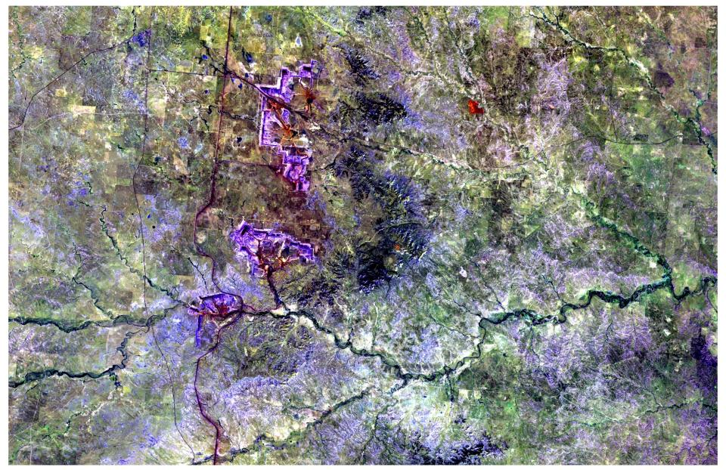
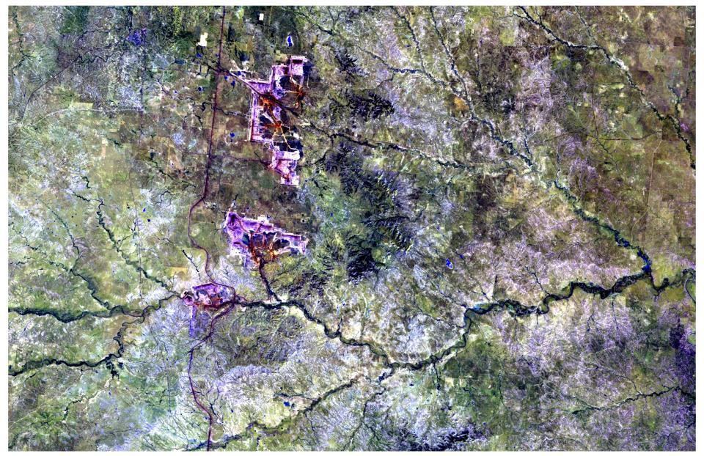
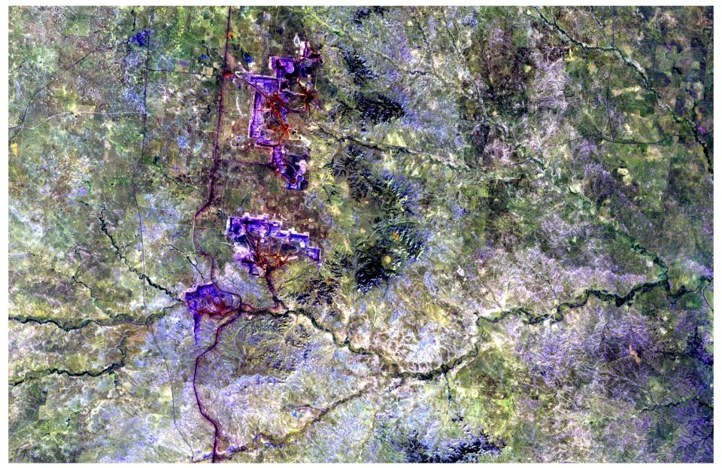
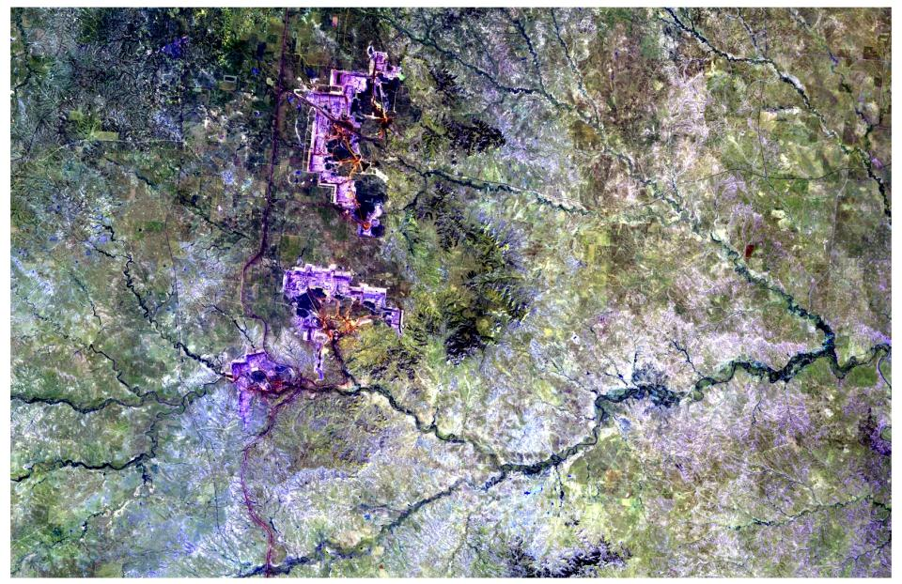
Landsat TM5 (Bands 7,2,5 Compost) Animation 1990-2007
1990
1994
1997
2000
2002
2003
2006
2007

Slide 5
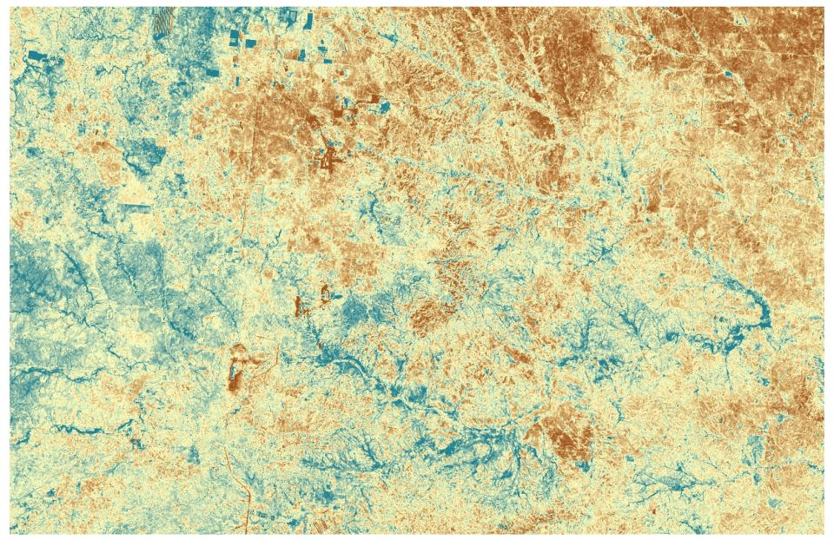
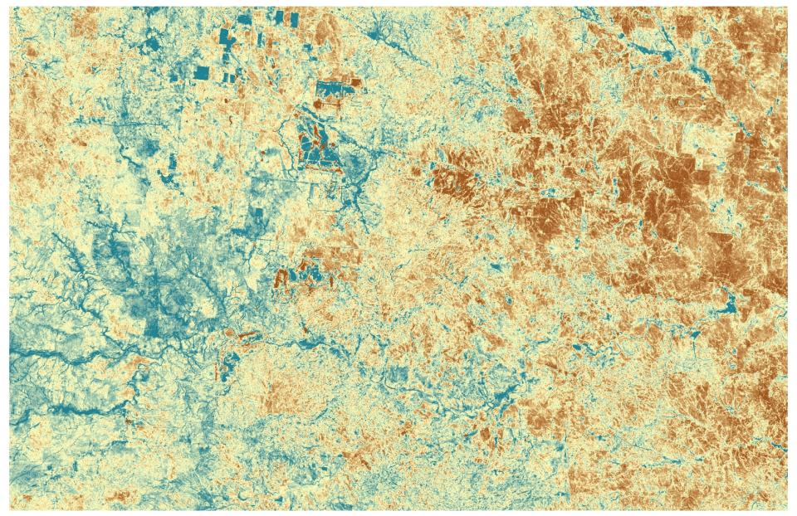
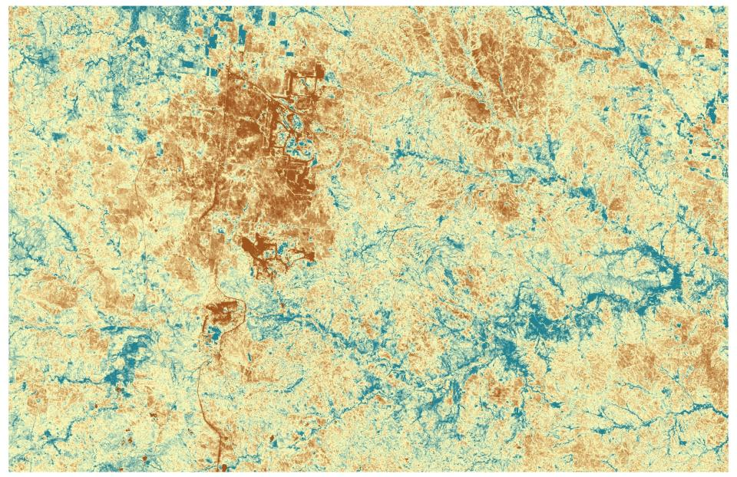
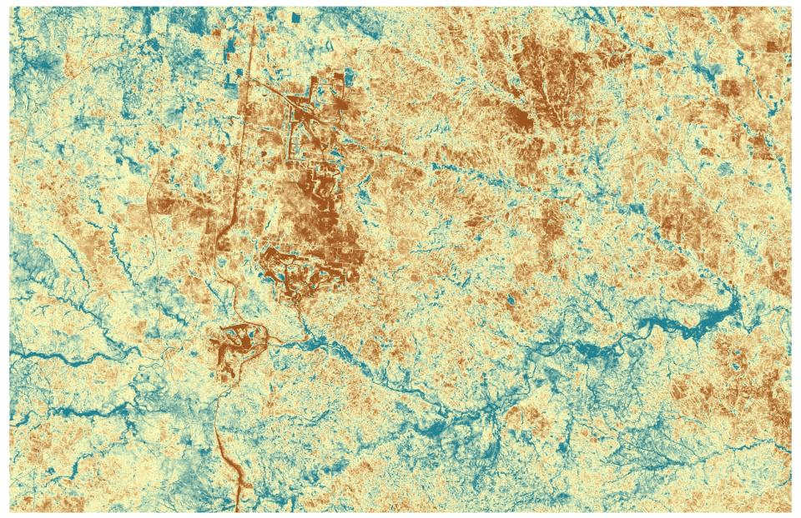
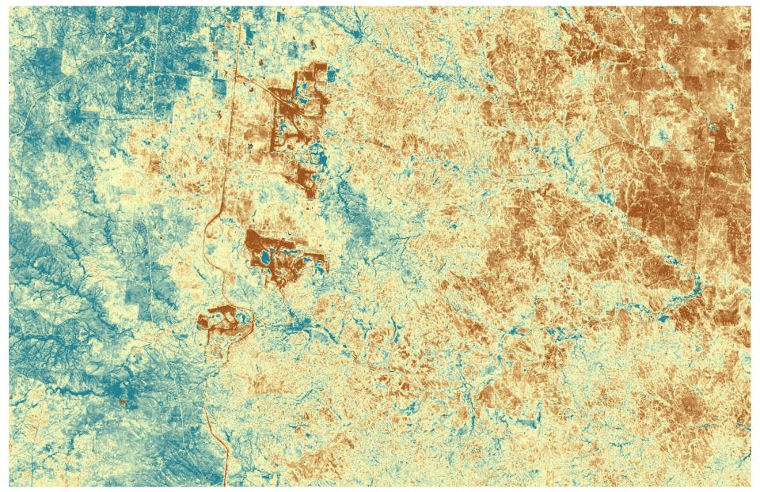
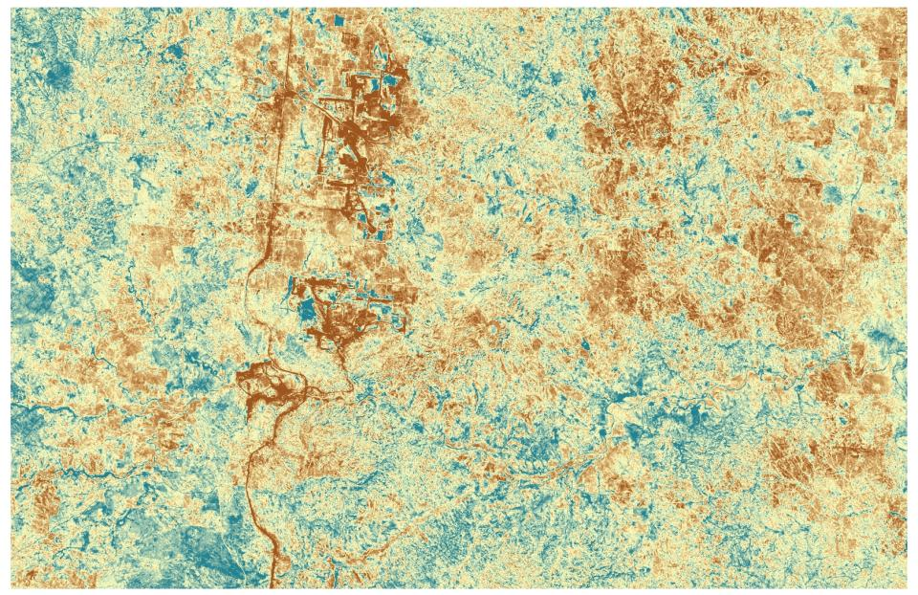
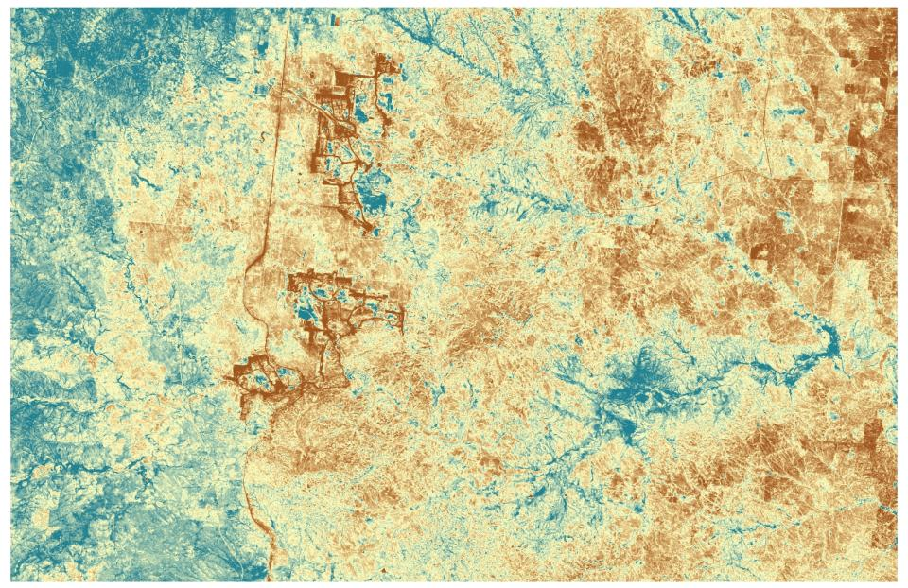
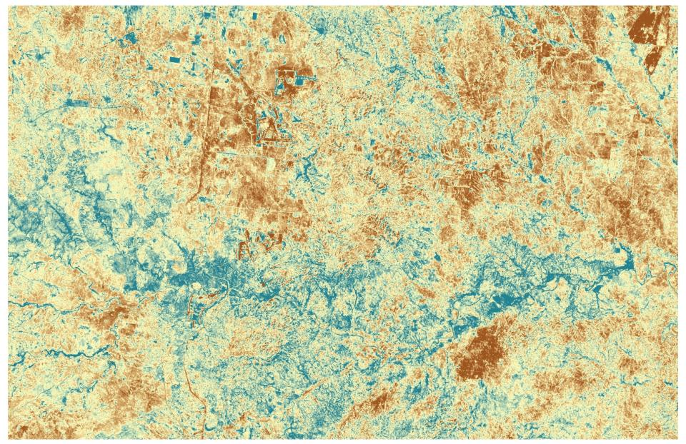
MSAVI Animation 1990-2007
1990
1997
2000
2002
2003
2006
2007
1994

Slide 6


1994
MSAVI
1994 & 2007
2007
NDVI corrected for soil brightness
Not biased by vegetation senescence

Slide 7
Entropy
Information content in random variable
H = -∑(P_{i}ln(P_{i}))
Where: P_{i} = Proportion of one value to total values P_{i}=n(p)/m
m = number of unique values
Maximum entropy is achieved when all values are different or ln(m)
Need integer (nominal) data

Slide 8
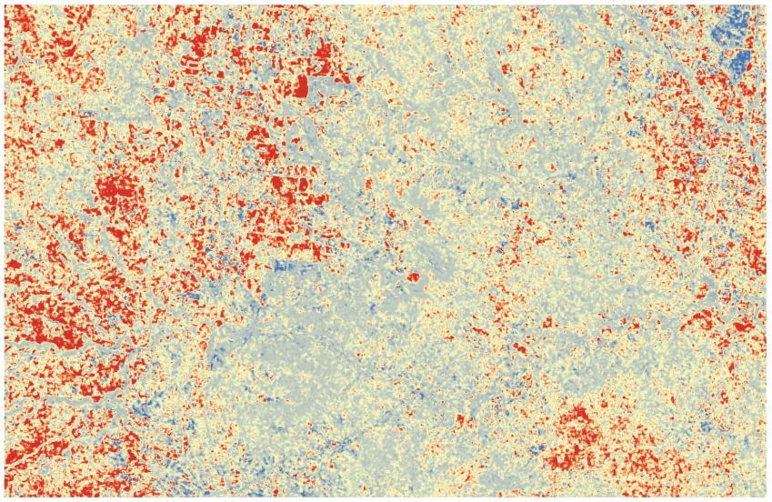
Entropy results

Slide 9
Fuzzy Set Theory
Calculates similarity distance matrix using 1-|a-b| / max[a,b] thus taking into account that there are “gradients of similarity” between times

Slide 10
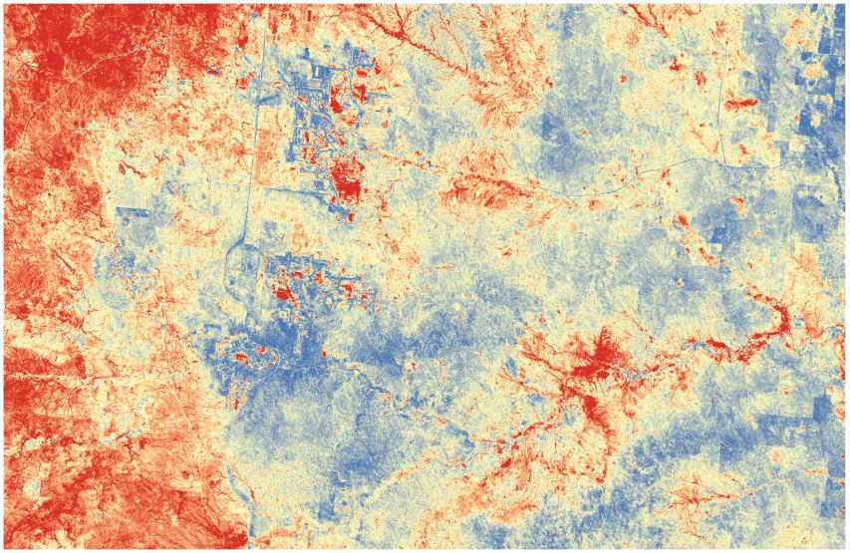
Fuzzy Set results

Slide 11
Bivariate autocorrelation
Moran’s-I (-1 to 1)
Bivariate version compares against a second variable rather than a self-lagged variable
Global coefficient is localized within specified radius
Juxtaposition of (1) high/low or (-1) low/high values.
Identifies outliers (hot spots)

Slide 12
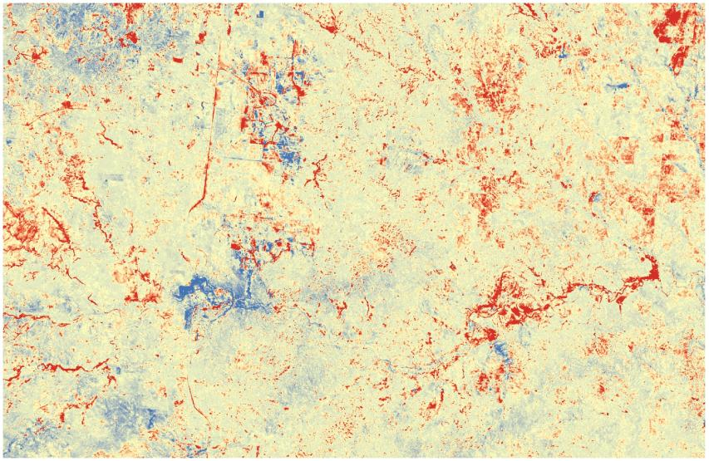
Bivariate autocorrelation results

Slide 13
Statistical time series models on observational data

Slide 14
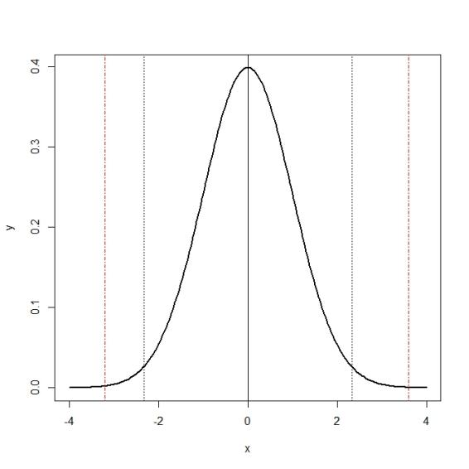
Normal distribution
-1 SD
+1 SD
10th
95th
Mean

Slide 15
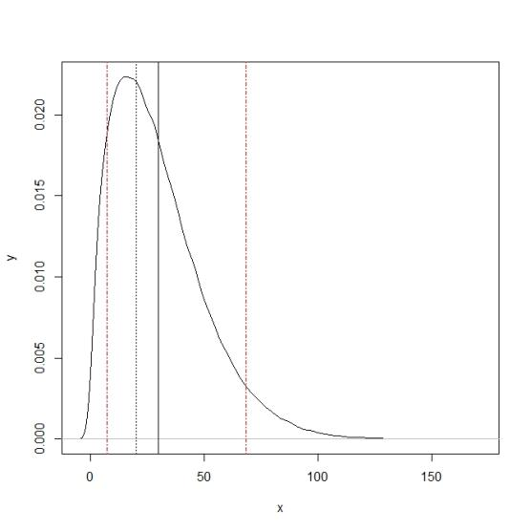
Non-normal (skewed) distribution
+1 SD
95th
10th
Mean

Slide 16
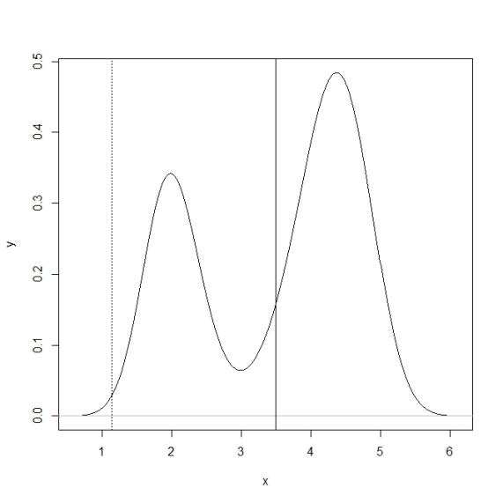
Non-normal (Multi-modal) distribution
Mean
+1 SD

Slide 17
Time series analysis
It is assumed that the data consist of a systematic pattern (cycle or trend)
Stochasticity and random noise can make the pattern difficult to identify
Very often non-linear data series
Most approaches involve some form of filtering in order to make the pattern more salient.

Slide 18
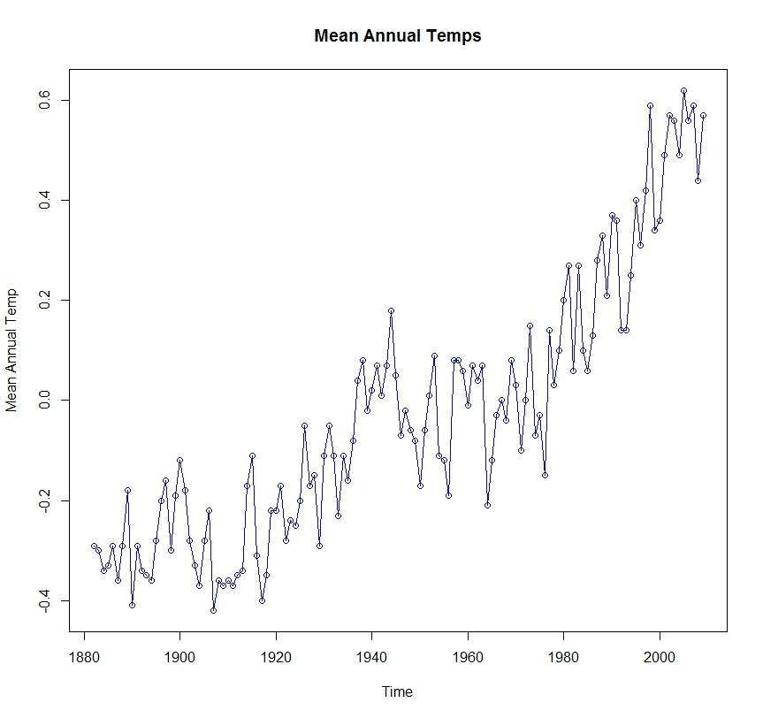
Time series

Slide 19
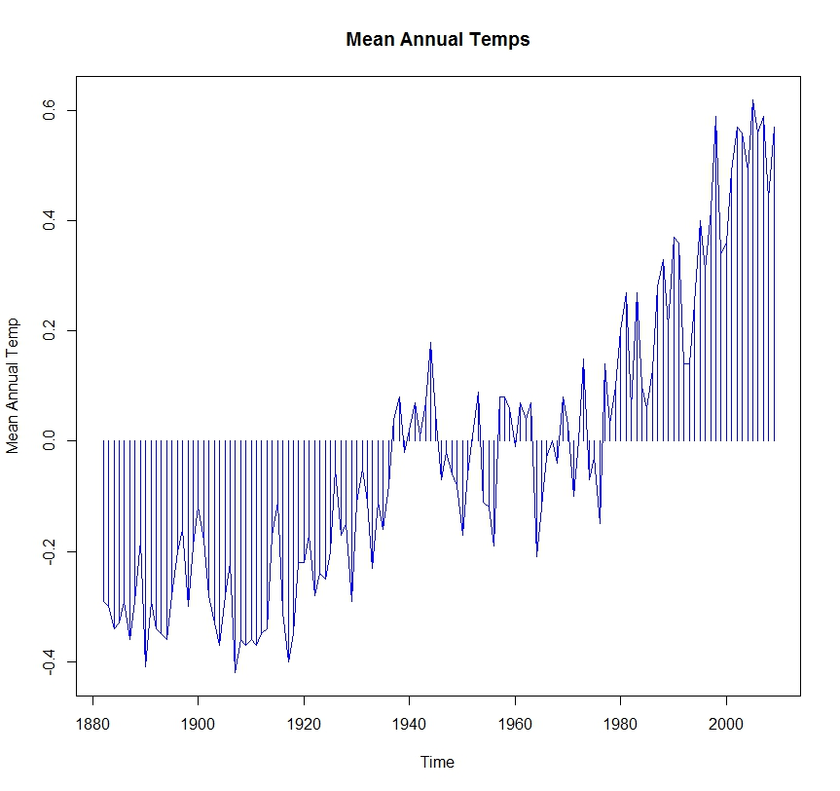
Time series (centered on 0)

Slide 20
Why not use OLS on time series data?
OLS estimates are sensitive to outliers.
OLS attempts to minimize the sum of squares for errors; time series with a trend will result greater weights on the first and last observations.
OLS treats the regression relationship as deterministic, whereas time series have stochastic characteristics.
We should not treat temporal dynamics as a nuisance but, rather draw inference from them.

Slide 21
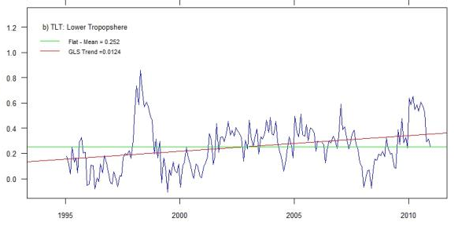
The danger of eyeball “inference”

Slide 22
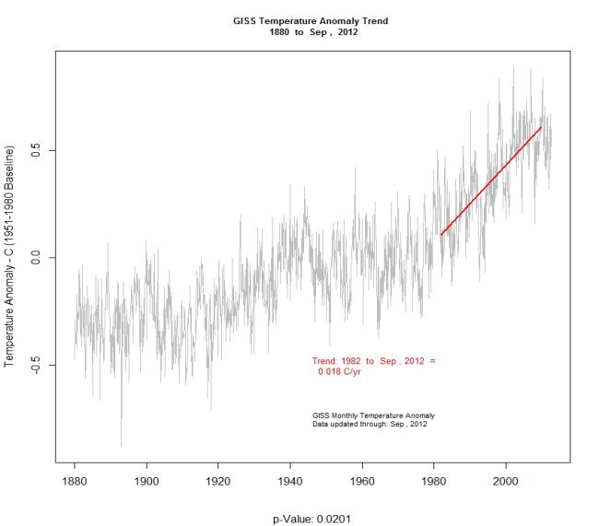
Trend in periodic patterns

Slide 23
Serial autocorrelation
Higher correlation with observations closer in the time series
Violates assumptions of independence
can bias trend
Can sometimes be corrected by normalization.
subtracting the mean and dividing by the variance
(x –mean(x))/var(x)
Avoided by using “nonparametric” approaches

Slide 24
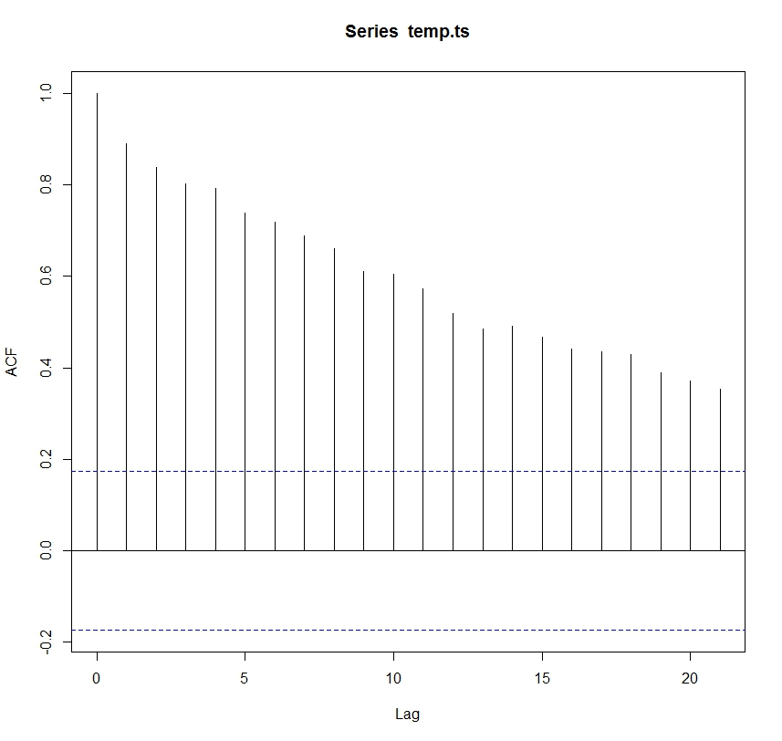
Serial autocorrelation

Slide 25
Seasonal variation (periodicity)
Decomposition - Isolates components, that is, to “decompose” the series into the trend effect, seasonal effects, and remaining variability
Spectral analysis - Analysis of underlying sinusoidal (sine and cosine) functions in periodicity (cycles in time series)
Census I - Separates “cycles” from overall trend
Periodic moving averages – Performs a moving average smoothing, conditional on cyclide variation

Slide 26
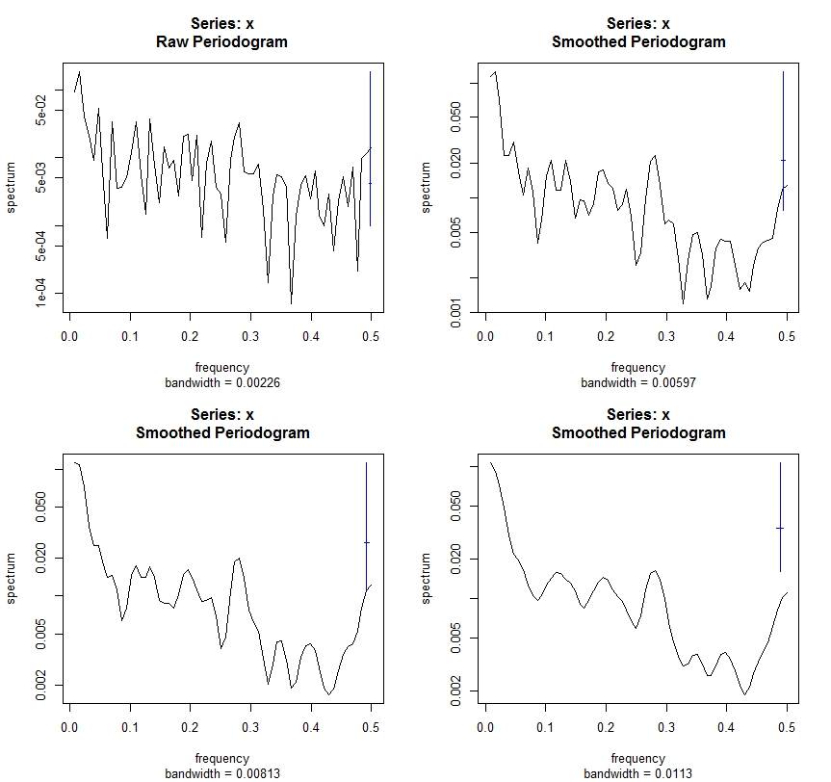
Spectral analysis

Slide 27
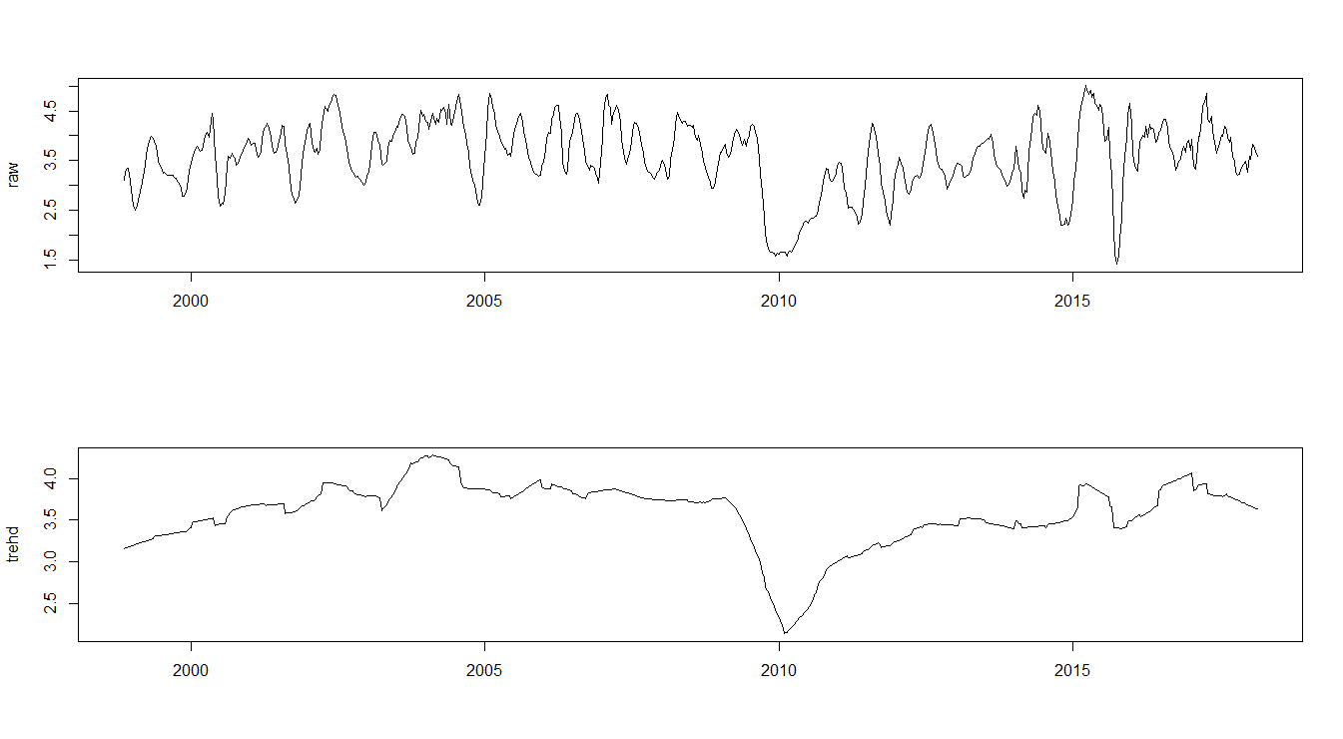
Bayesian Ensemble Models

Slide 28
Methods

Slide 29
Naïve Methods - Rate of Change
Rate or magnitude of change between two time periods
roc = [(date 1 – date 2) / date 1 * 100]
Does not capture true trend nor represent all of the data!

Slide 30
Trend analysis
Fit linear or nonlinear trend to data
Smoothing - replaces each element of the series by either the simple or weighted average of n surrounding elements
Function - approximated linear function using transformation of linear model

Slide 31
Smoothing – Linear and nonlinear trend
Moving Window - Simple smoothing using n^{th} order neighbors
Spectral analysis - Analysis of density in periodicity (cycles in time series)
Wavelet analysis – Flexible multiscale approach for fitting to an expected distribution

Slide 32
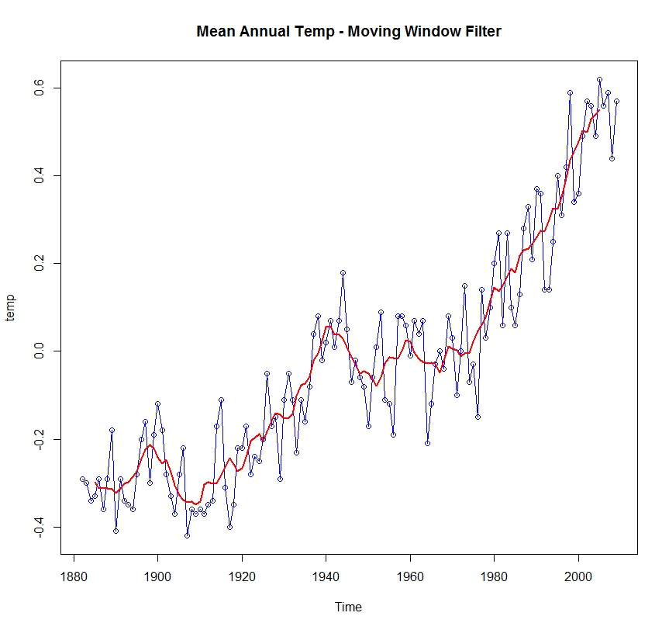
Time series with moving window trend

Slide 33
Regression – Linear and nonlinear trend
Ordinary Least Squares – Vanilla linear regression (time ~ x)
Mixed Effect Models – Uses an autoregressive ARIMA(I) term to account for serial autocorrelation (required for forecasting)
Splines – Semiparametric approach that can fit nonlinear trend
Lowess – Nonparametric polynomial regression that can fit nonlinear trend
Kendall’s Tau – Represents the correlation of observations through time.

Slide 34
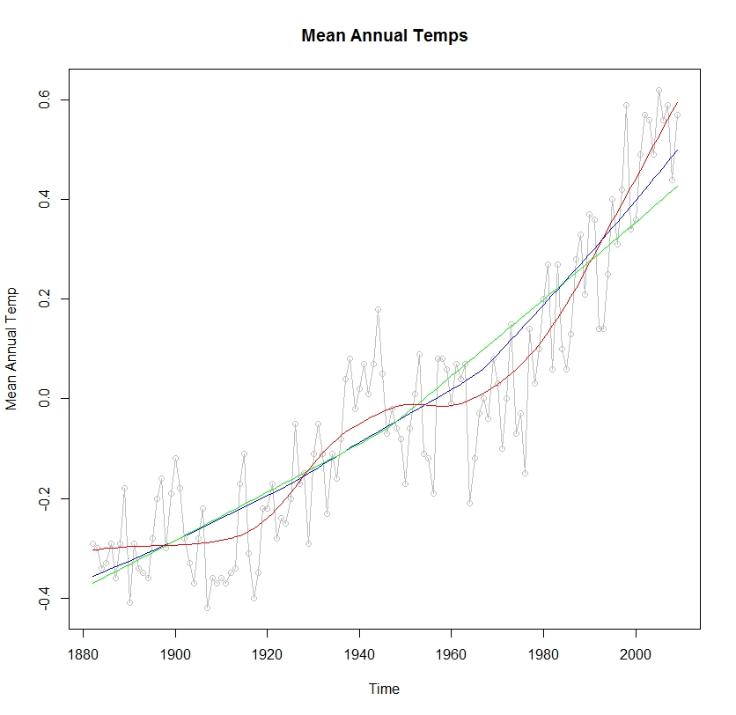
Time series with lowess regression

Slide 35
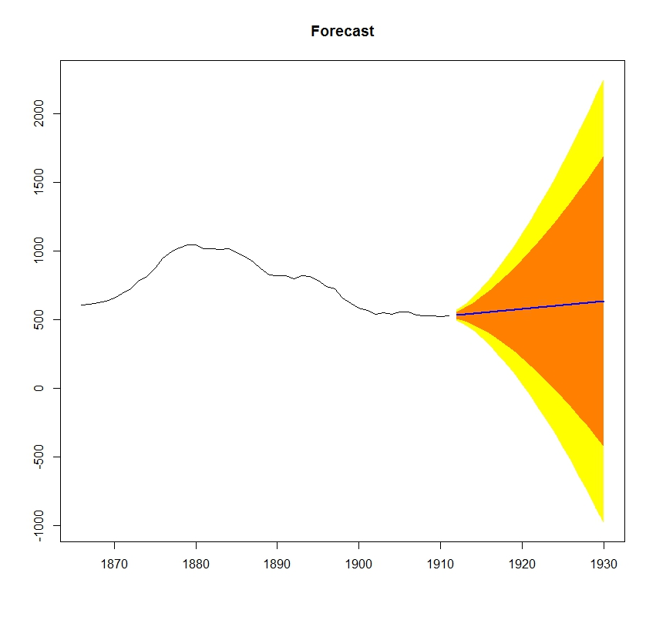
Forecasting with AR(I) or ARIMA

Slide 36
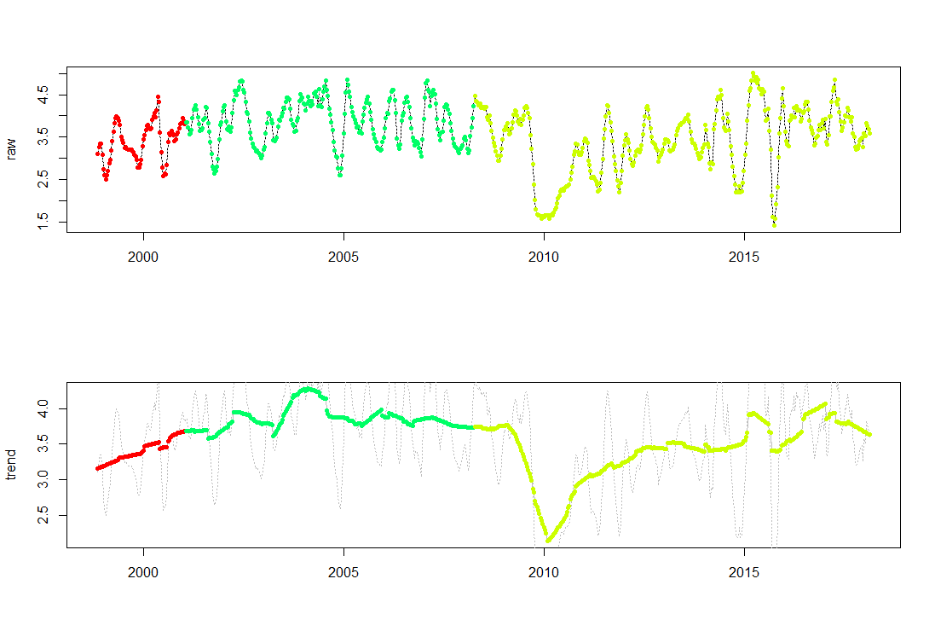
Change point and Markov Process
HSMM states (East Kalimantan example distribution)
HSMM states applied to seasonally detrended data

Slide 37
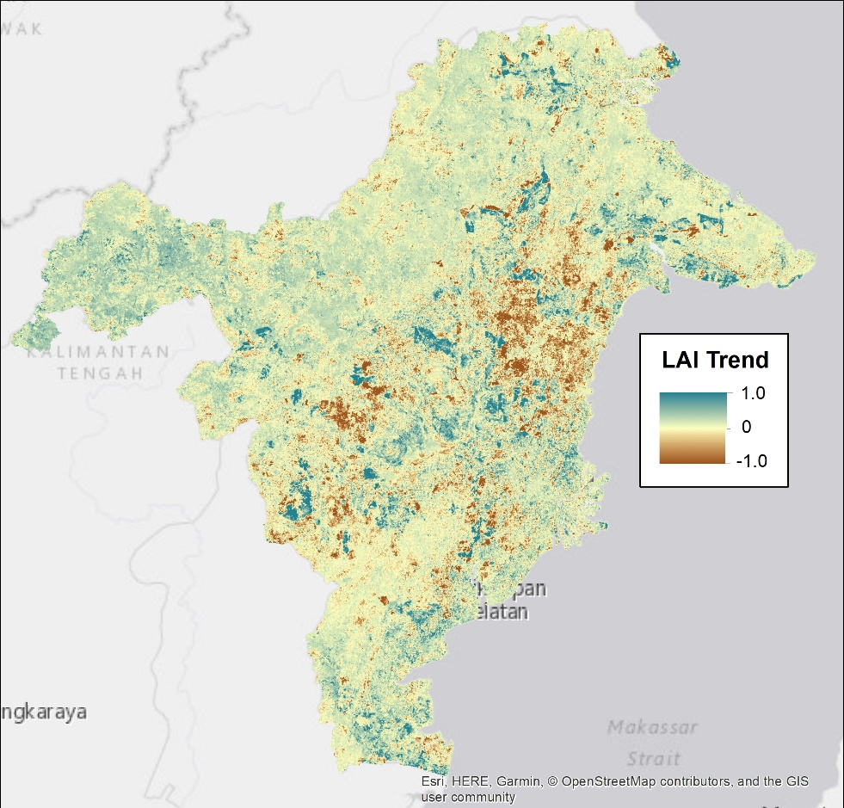
Monotonic slope
Sen’s monotonic linear slope

Slide 38
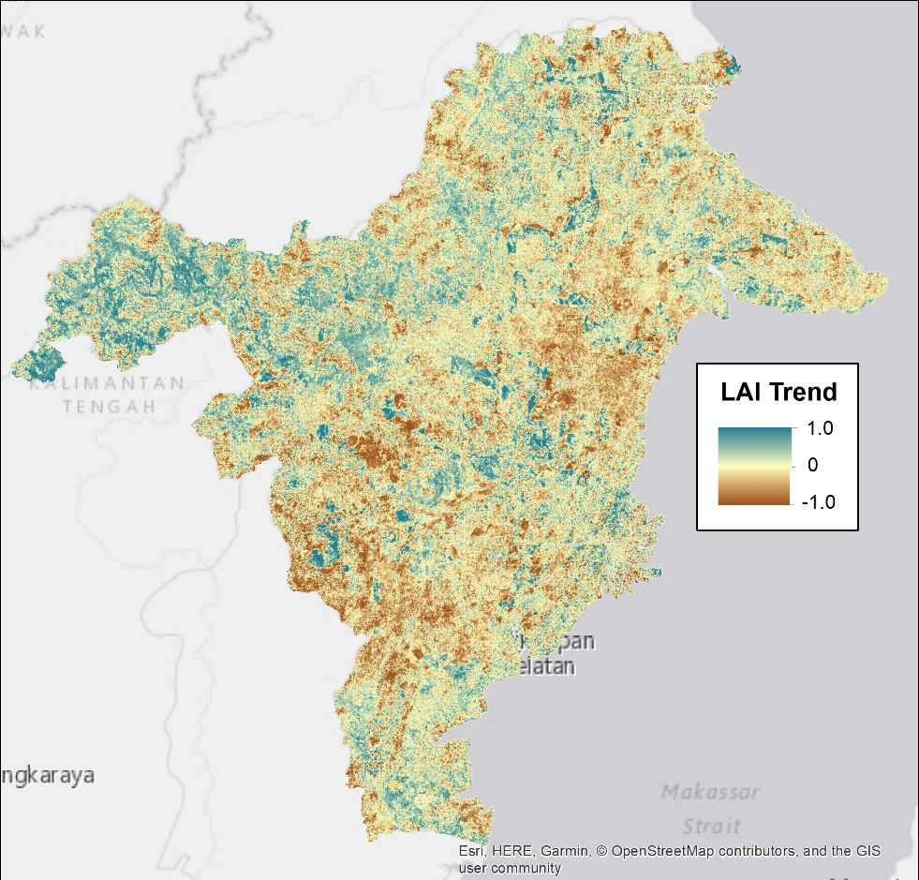
Kendall Tau Temporal correlation
Tau (correlation)

Slide 39
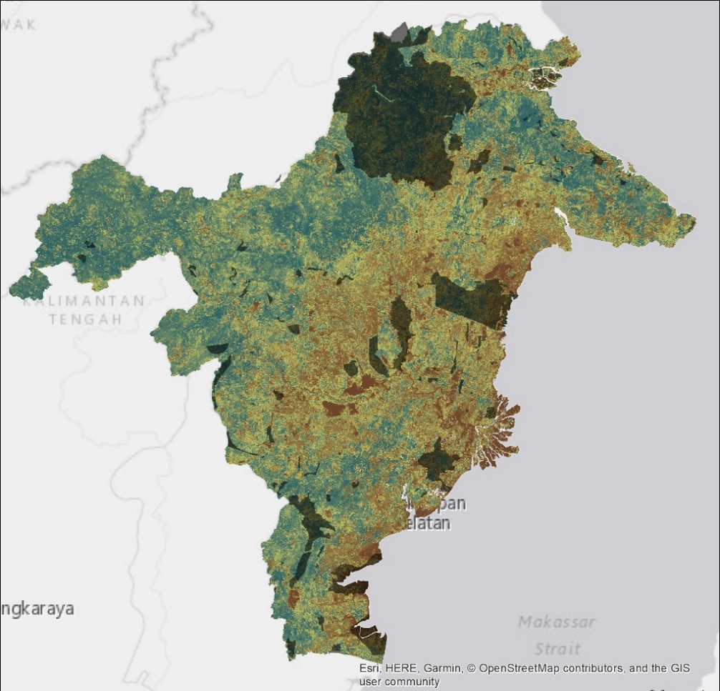
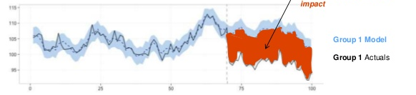
Interventions
Causal Impact Analysis
The difference between the model and observed gives us an estimate of effect
Counterfactual (p2)
Impact (effect size)
Observed (p1)
Effect size of intervention(s)

Slide 40
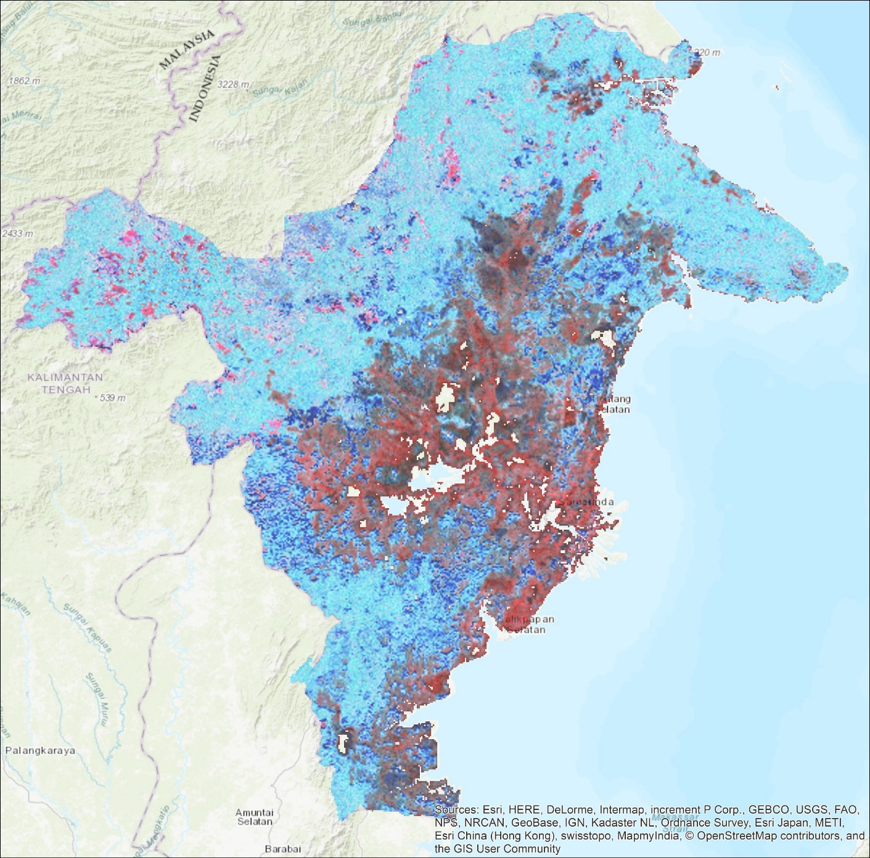
Hidden State Markov Model State and transition

Slide 41

Questions

